Slide 1

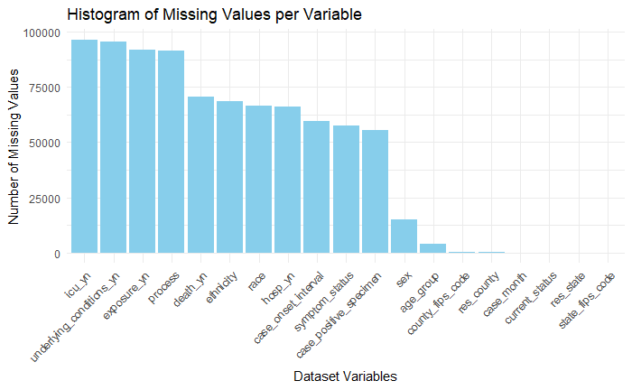
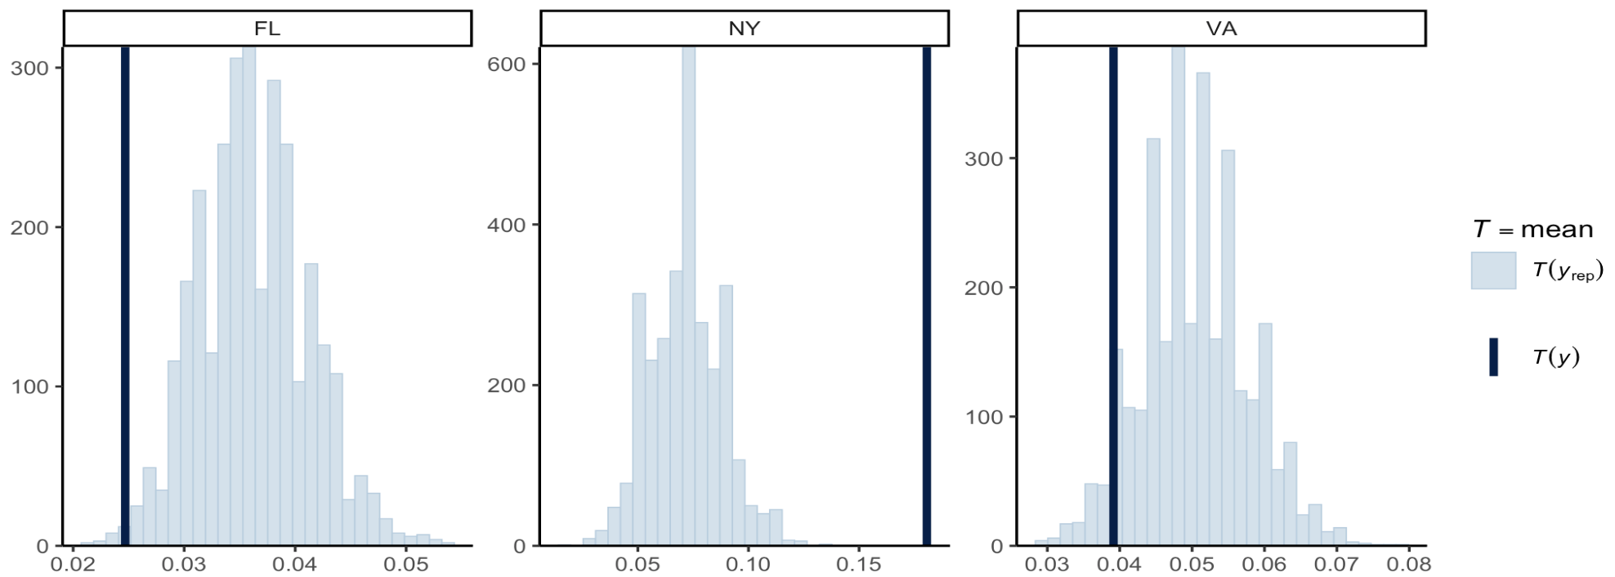
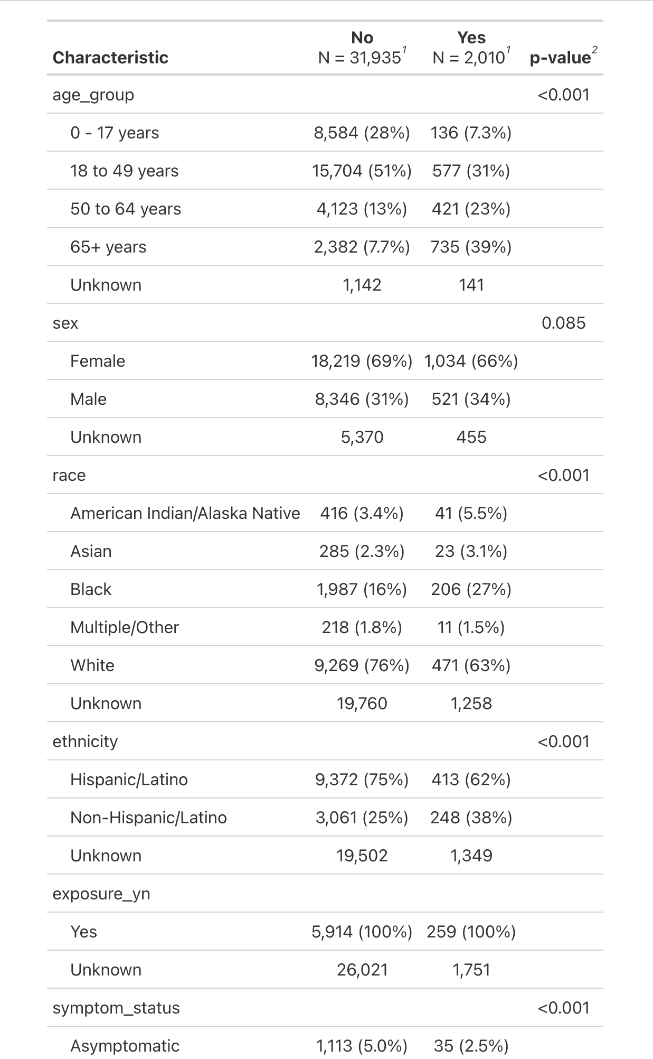
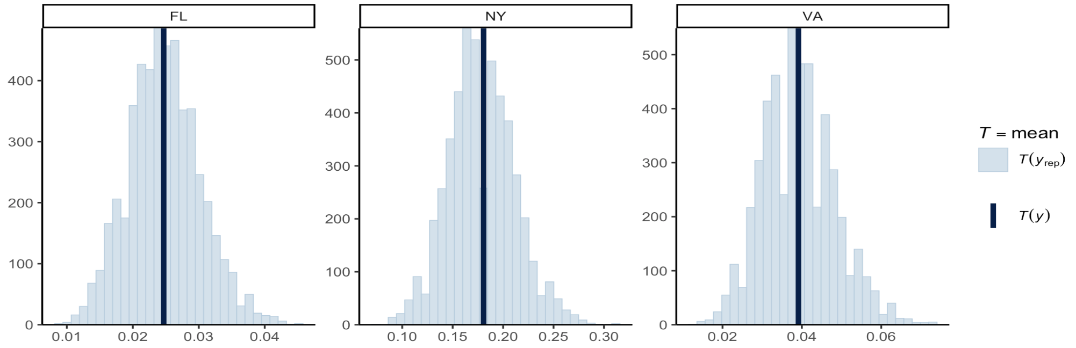


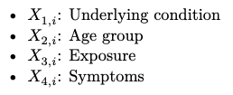
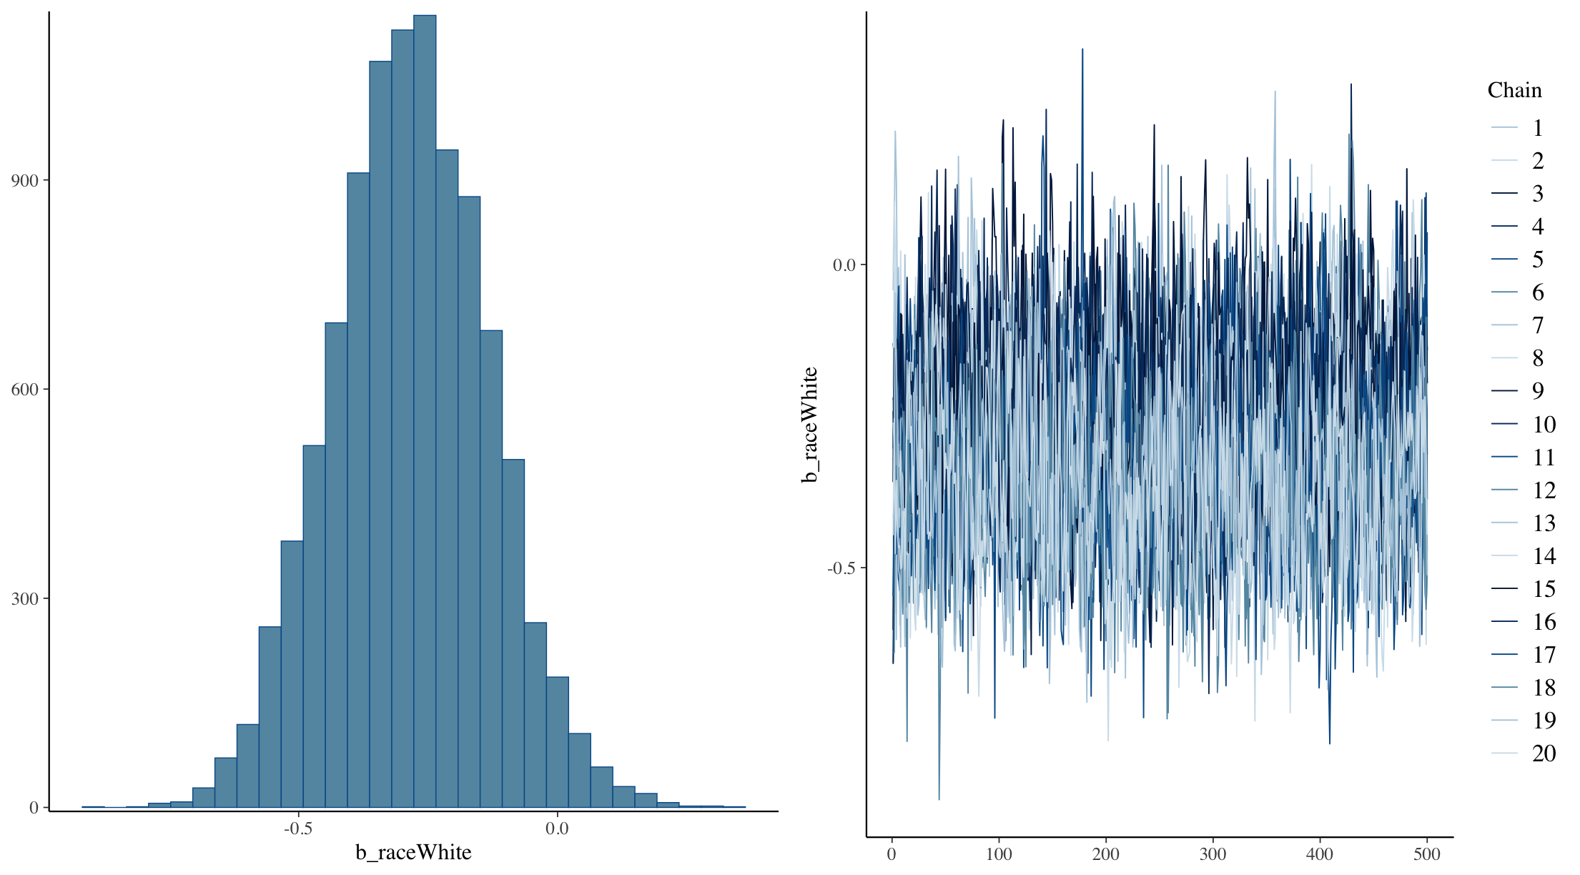
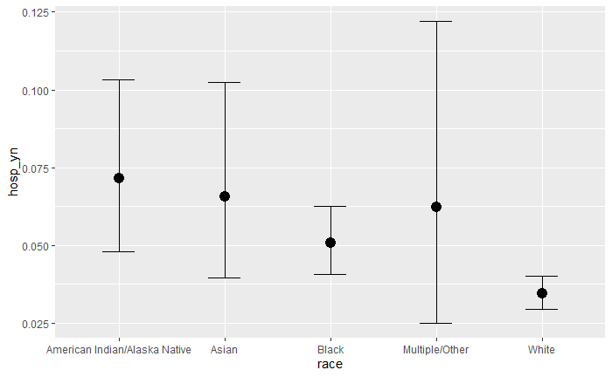
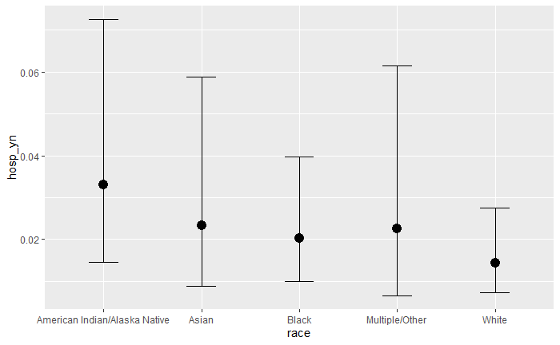

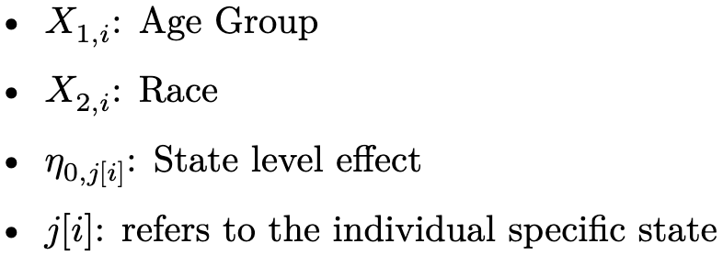
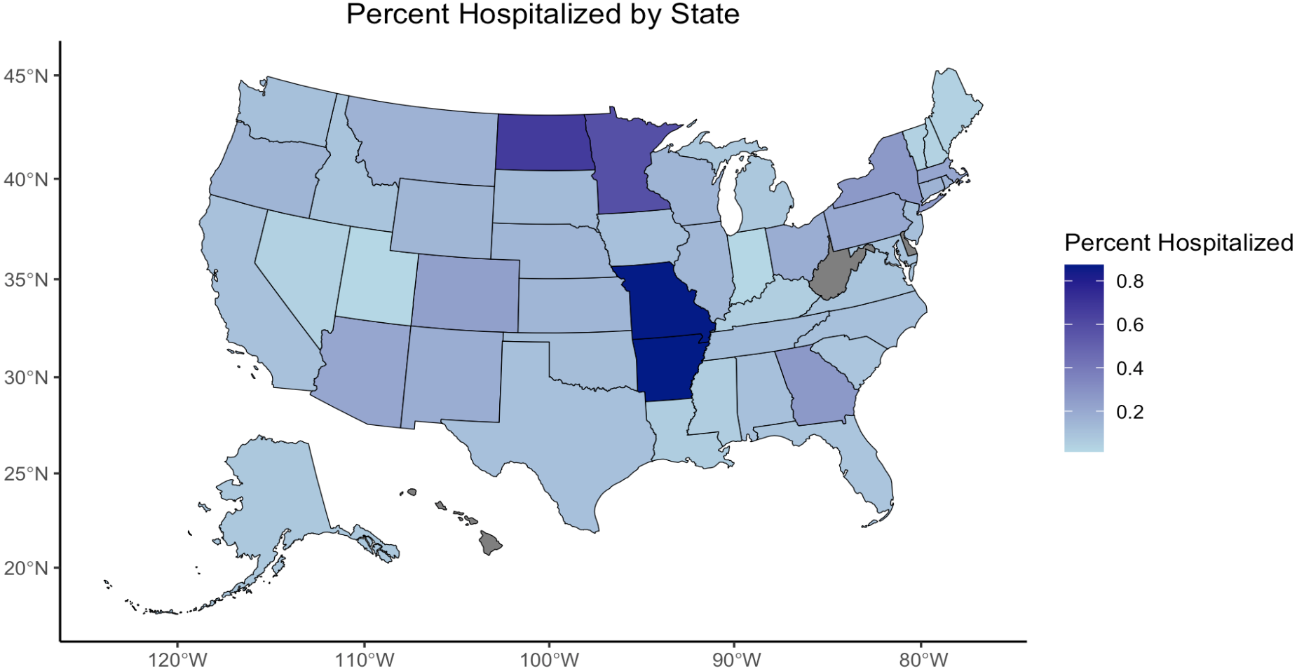
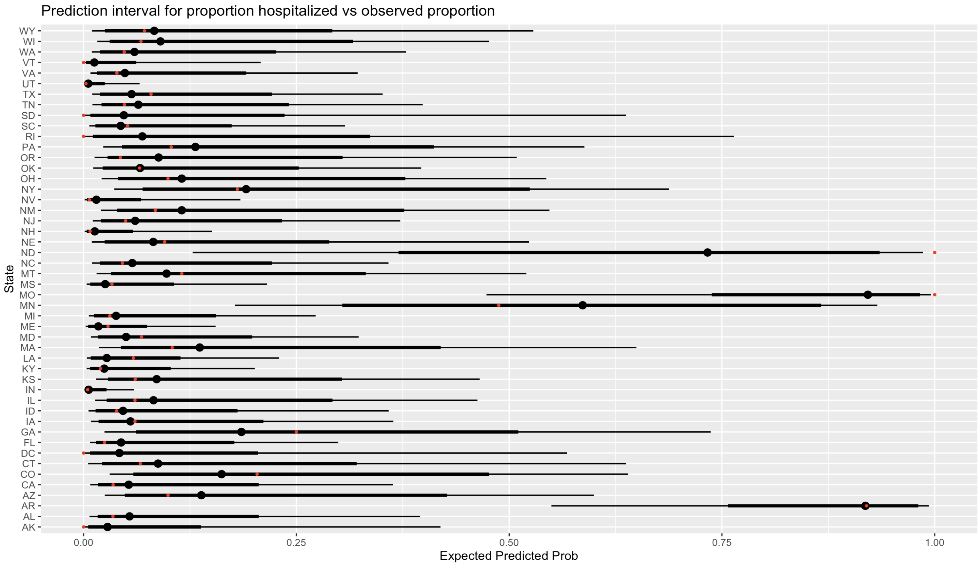
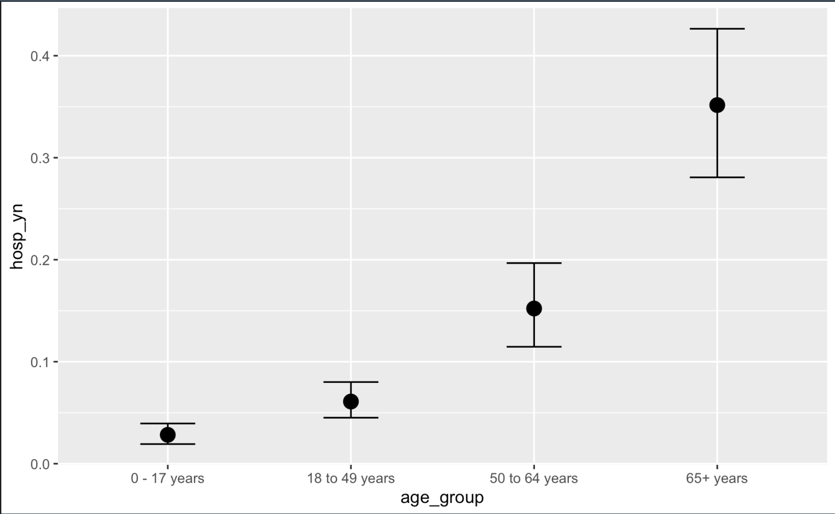
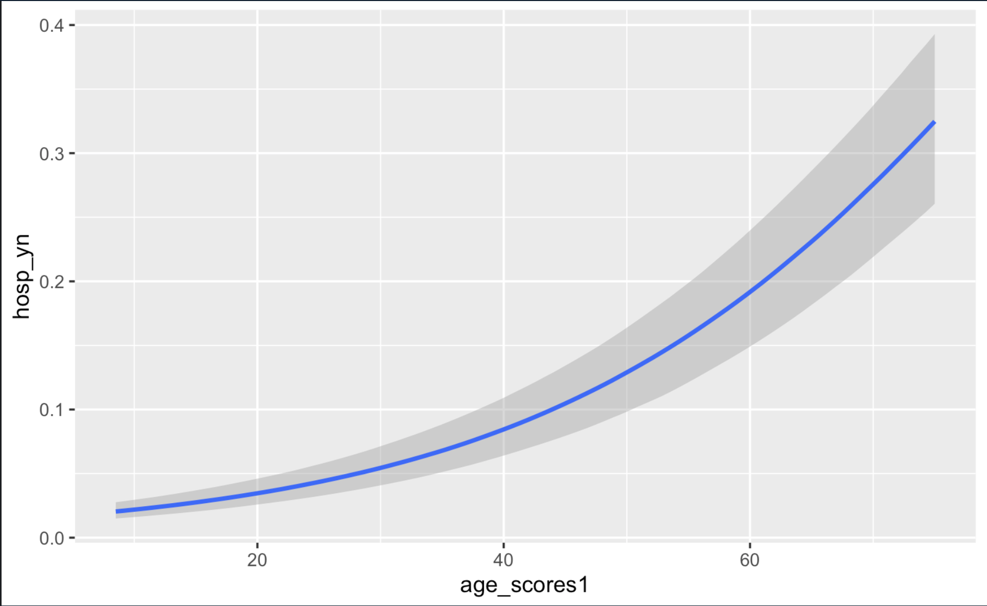
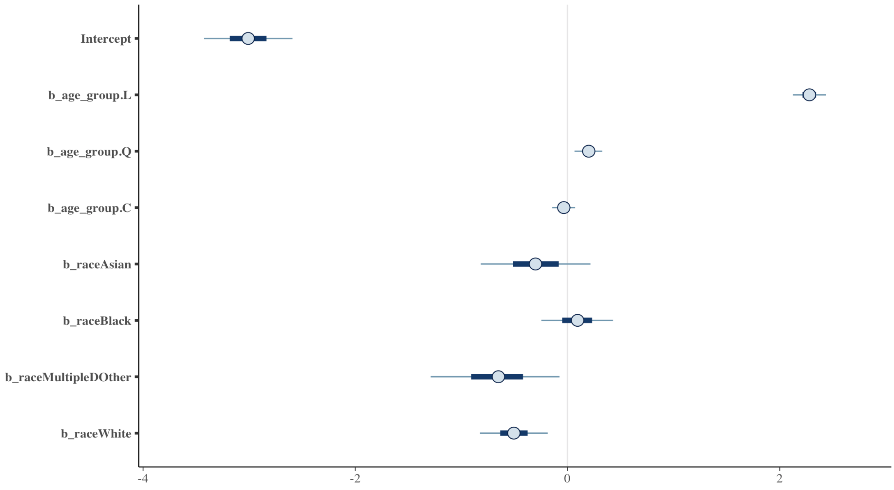
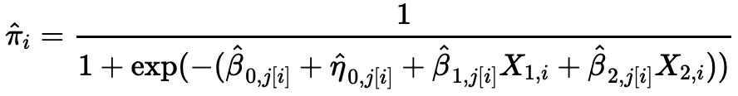
Hospitalization Prediction Modeling for COVID Luke Wilsen, Alexander Ruse, Ben Gerber
UMass Chan Medical School | UMass - Amherst
Background
Methods
Results
Rationale
Missing Data and Multiple Imputation Approach
Model Checking
Hospitals in the U.S. were overrun during the COVID pandemic due to limited resources and increased burden of illness. Public health and healthcare organizations need to prioritize care (using hospital beds for severe cases).
An accurate prediction model may help identify those at high risk and need for hospitalization (resource efficiency). However, early stages in the pandemic had under-reporting of COVID across certain regions of the U.S.
The purpose is to develop a prediction model for COVID hospitalization, including a hierarchical model by state, and estimate hospitalization rates
We considered two approaches:
1. Imputation before model fitting: each missing value is not imputed once but m times leading to a total of m fully imputed data sets (using mice).
2. Imputation during model fitting: more complex than imputation before model fitting, because one has to take care of everything within one step (including imputation with brms)
We used the mean to compare how well each model fit the observed data
Base Model (hospitalized(binary) ~ age group + race)
Data Source
We retrieved publicly available COVID case surveillance data from the CDC.
Data structure (individual case level):
Bivariate and Multiple Imputation Analyses
We imputed m = 5 datasets (really need ~100!) with brm_multiple to fit model
Pooling results of multiple imputed datasets combined the posterior draws of the sub-models
Rhat values were high and ESS low indicating convergence problems (may be false positives, since chains of different sub-models may not overlay each other exactly, fitted to different data).
Model Development
The hierarchical model outperformed the baseline model with an elpd difference of -104.9 and a standard error of 15.8, indicating significantly better predictive accuracy.
Conditional effects show decreased influence/effect of race from base model to hierarchical model
Outcome variable: where:
Initial predictors:
Initial Model:
Priors
For regression coefficients, we used a normal prior with mean 0 (implying no initial change) and standard deviation 2
The intercept, also followed a normal prior with mean but a wider standard deviation of 5
For random-effect standard deviations, Student’s t prior with 3 degrees of freedom, mean 0, and scale 2.5.
Model Exploration
We considered recoding the age group variable as the mean of the age group boundaries
Base Model Hierarchical Model
But when summary run on each sub-model, they were fine!
Final Model Hospitalization Rates
Final Model and Summary
Map of Predicted Hospitalization Probabilities
95% Credible Intervals of Predicted Probabilities
Final predictors:
Final Model:
Model Summary
CI’s of Model Parameters
Predicted hospitalization probabilities:
Variable Selection
Dropped Underlying Conditions (Missing data for 95% of obs)
Dropped Symptoms (95% of obs had symptoms, and literature says that symptoms are not a good predictor of severity (need citation)
Added a state level effect predictor, to account for between state variability
Conclusions and Limitations
Age clearly increases risk of hospitalization; race in bivariate associated with increased risk but not in full adjusted model (examining conditional effects)
Missing data is a substantial limitation
When we combined the imputation models, they performed poorly, indicating that our model could be overly sensitive to the specific data patterns introduced during imputation. Consequently, the imputed models fail to generalize well to the underlying data structure.
States with smaller sample sizes more likely to have inaccurate raw hospitalization rates. However, the Bayesian hierarchical model did well to predict sample from states with fewer cases. The hierarchical model improved accuracy of prediction overall.
References
Chen J, Song JJ, Stamey JD. A Bayesian Hierarchical Spatial Model to Correct for Misreporting in Count Data: Application to State-Level COVID-19 Data in the United States. Int J Environ Res Public Health. 2022 Mar 11;19(6):3327. doi: 10.3390/ijerph19063327. PMID: 35329019; PMCID: PMC8950980.
Enhancing the prediction of hospitalization from a COVID-19 agent-based model: A Bayesian method for model parameter estimation
Hadley E, Rhea S, Jones K, Li L, Stoner M, et al. (2022)
https://cran.r-project.org/web/packages/brms/vignettes/brms_missings.html

